Slide 1
Fargo Health Group – Case Study
Managing the Demand for Medical
Examinations Using Predictive Analytics
By Pete Kelley - DS700

Slide 2
Business Problem
Fargo Heath Group provides disability compensation benefits to thousands of patients every year
The disability examination process starts with the patient submitting a request for disability compensation to one of the organization’s 34 Local Offices (LOs)
The LO often forwards the request to one of Fargo’s 34 Health Centers (HCs), requesting that the HC perform the necessary disability examinations
The HCs have a service level agreement (SLA) to complete and send back the results of disability examinations within 30 days
Each day beyond the allocated 30-day timeframe costs Fargo $200 worth of fines paid to the Regional Office of Health Oversight (ROHO).
Overdue examinations negatively impact the health and wellbeing of patients as well as the reputation and financial condition of Fargo

Slide 3

Business Problem
HCs are often late completing the requested examinations and exceed the 30 day SLA or return the request to the requesting LO with an explanation of being understaffed
The LO with either try to find another HC or more likely reroute the request to one of the neighboring out of network Outpatient Clinics (OCs)
Rerouting of requests to OCs represents a major financial and reputational burden for the origination
The OC don’t belong to Fargo’s network and cost an average of $1,250 more than what Fargo would have paid the HC to perform the examination.
The OCs also aren’t bound by the 30 day SLA

Slide 4
Goals of the Pilot Study
Use data drive approach to understand historical examination demand
Develop model to forecast examination demand
List recommendations that will allow better patient service at a lower cost
In-scope for pilot
HC located in Abbeville, Louisiana
Cardiovascular examinations
Dates between Jan 2006 and Dec 2013

Slide 5
Data Cleaning
Removed Oct 2008 Incoming exams: Hurricane Katrina
Cleaning Data
Date format fixed by removing a comma between the month and year.
May-2007 Violet, LA Worksheet
May-2007 Lafayette, LA Worksheet
May-2007 Baton Rouge, LA Worksheet
Examination codes lacked uniformity between Health Centers
Built mapping table for all examination descriptions across all of the HC that are heart-related

Slide 6
Data Aggregation
December 2013 Data Worksheet
SYSID starts with “L839” and ends either in “TGU3” or “ROV8”
SYSID included one of the condition codes listed on Worksheet Heart-related Condition Codes
Include only rows that meet all conditions
May-2007 Worksheets
Count only rows that contained the following :
Original Hospital Location = “Abbeville”
Examination was heart-related
Date = May 2, 2007
Count rows that contained the following
May 2013, June 2013 or July 2013
Original Hospital Location = “Abbeville”
Examination was heart-related

Slide 7
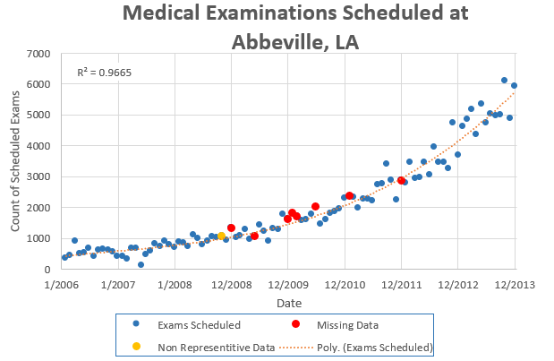
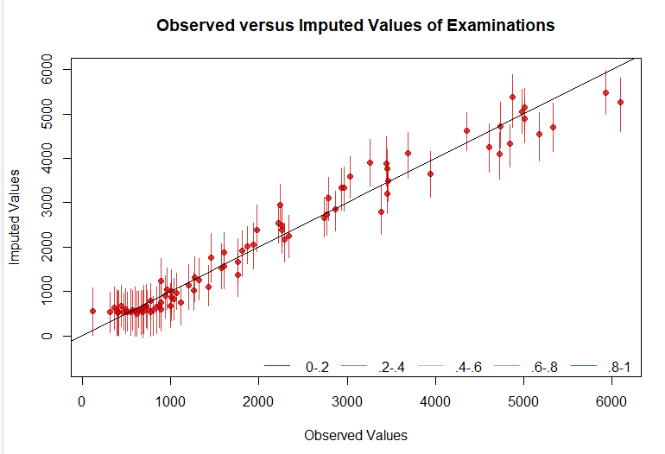

Imputing Missing Values
Using library Amelia for imputing missing values
Assumptions
Data had seasonality that needed to be preserved
A good model would be one that imputed values fell close to a best fit line
Amelia produced 5 models
Used a least squares approach to pick model that best fit original seasonality

Slide 8
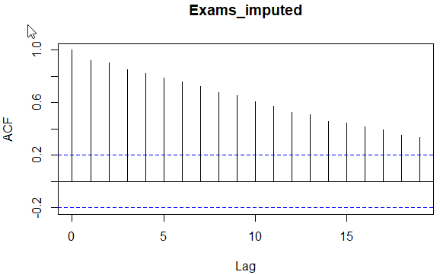
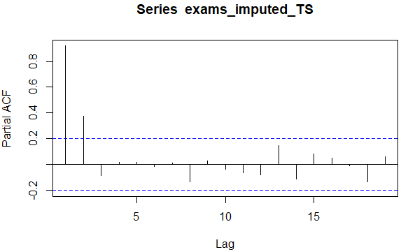

Building Predictive Model
Holt-Winters
Allowing R to find the best coefficients showed that the data does have seasonality aspects to it.
alpha: 0.2287, beta: 0.1296
Assess the time series using ACF (autocorrelation function) and PACF (partial autocorrelation function) – indicate autoregressive and have moving averages

Slide 9
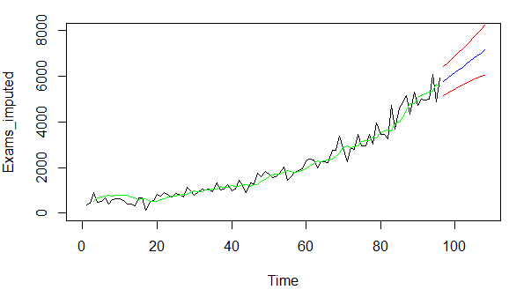
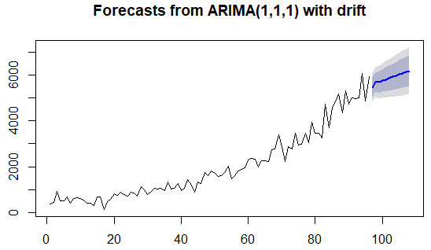

Building Predictive Model
ARIMA
Combination of Autoregression and Moving Averages
Which is better?
Holt-Winter with seasonality

Slide 10

Comparing the Models
Holt-Winters Model
MAD: 249
MSE: 106365
MAPA 21.84%
ARIMA Model
MAD: 235
MSE: 104,243
MAPA 21.45%
ARIMA model is the best fit

Slide 11

Model Forecast
Forecasted heart-related exams at Abbeville, Louisiana HC over the next 12 months.
Year | Month | Lo.95 | Lo.80 | Point.Forecast | Hi.80 | Hi.95
2014 | 1 | 4832 | 5054 | 5475 | 5895 | 6118
2014 | 2 | 5049 | 5275 | 5702 | 6130 | 6356
2014 | 3 | 4980 | 5229 | 5697 | 6166 | 6414
2014 | 4 | 5017 | 5278 | 5771 | 6264 | 6526
2014 | 5 | 5022 | 5298 | 5818 | 6339 | 6615
2014 | 6 | 5041 | 5329 | 5875 | 6420 | 6709
2014 | 7 | 5057 | 5359 | 5928 | 6497 | 6798
2014 | 8 | 5076 | 5390 | 5982 | 6574 | 6888
2014 | 9 | 5096 | 5422 | 6036 | 6650 | 6975
2014 | 10 | 5118 | 5454 | 6090 | 6725 | 7062
2014 | 11 | 5140 | 5488 | 6144 | 6800 | 7147

Slide 12

Recommendations
Next steps:
Use the model to schedule resources to improve patent quality of care and financial performance at the Abbeville, Louisiana HC.
Expand the study to develop a model for cardiovascular examinations at neighboring HC
Synergy
When several HCs are scheduling based on most likely demand for a their location, neighboring HCs will be more likely to have available recourses to assists each other in addressing a local spike in demand.
Improving patent quality of care
Reduced cost of outsourcing examinations
Expand the study to develop a model for additional examination classification

